Slide 1
The Inspiration, Authority, and Inerrancy of the Bible
Acts Community Church

Slide 2
Key Questions to answer
What actually is the “Bible”?
How did it come to be, as we have it today?
Is it reliable?
Is it authoritative?
Is it God’s inspired Word?
Do we have any of the original writings?
Do we have enough ancient manuscripts of it?
Could there be erors in copying it?
Could there be errors in translating it?
Could there be errors in interpreting it?

Slide 3
Inspiration & Authority
When we speak of Scripture’s inspiration, we are speaking about the nature of Scripture - the basic, inherent feature of Scripture which is characteristic about it.
When we speak of Scripture’s authority, we are speaking of its right to govern, judge and shape all of a Christian’s life and beliefs.
The two concepts are vitally connected to one another, as we will explore today.

Slide 4
The Nature of the Bible
Inspired by God
Every scripture is inspired by God (2 Tim 3:16; NET Bible).
No prophecy of scripture ever comes about by the prophet's own imagination, for no prophecy was ever borne of human impulse; rather, men carried along by the Holy Spirit spoke from God (2 Pet 1:20-21; NET Bible).

Slide 5
The Nature of the Bible
Definition of Inspiration: The act of the Holy Spirit in which He superintended the writers of Scripture so that, while writing according to their own styles and personalities, they produced God’s Word, written, authoritative, and free from error in the original writings (Paul Enns, The Moody Handbook of Theology, 638)

Slide 6
Two Implications of Inspiration
First: The Bible is a human book
1. Authors used their own language, writing methods, style of writing and literary form of writing
2. Authors wrote to an audience in a specific historical context for a specific purpose.
3. The Bible is influenced by the culture in which the author wrote.
4. The Bible has over 40 authors and was written over a time period of 1500 years.

Slide 7
Two Implications of Inspiration
Second: the Bible is a Divine Book:
1. The Bible is inerrant
2. The Bible is authoritative
3. The Bible has unity (66 books; about 40 authors over 1500 years). It has a consistent message and can be compared with itself for proper interpretation.
4. The Bible has an element of mystery: some passages may be hard to understand.
5. The Bible has an interpretation to it that is intended by God

Slide 8
Example of Matt 1:22-23
This all happened so that what was spoken by the Lord through the prophet would be fulfilled: “Look! The virgin will conceive and bear a son, and they will call him Emmanuel.”
1. The OT passage of Isaiah was spoken “by the Lord” (Divine ultimate source)
2. The OT passage of Isaiah was spoken “through the prophet.” (Human intermediate source)

Slide 9
A. PAUL: 2 Timothy 3:16-17
CONTEXT
Last recorded words of the apostle before his martyrdom.
Warning of “times of difficulty” for the church (v.1-7)
Paul is warning Timothy about false teachers among the people (v.8)
Paul guarantees the road ahead will be hard (v.12-13)
What is Paul’s admonition to Timothy in light of this dangerous threat to the early church?

Slide 10
2 Timothy 3:14-17
“But as for you, continue in what you have learned and have firmly believed, knowing from whom you learned it and how from childhood you have been acquainted with the sacred writings, which are able to make you wise for salvation through faith in Christ Jesus. All Scripture is breathed out by God and profitable for teaching, for reproof, for correction, and for training in righteousness, that the man of God may be complete, equipped for every good work.”

Slide 11
II. GOD-BREATHED θεόπνευστος
Paul says that all scripture is “theopneustos”: Some translations render the Greek word as “inspired by God” (NASB) or “God-breathed” (NIV) or “breathed out by God” (ESV).
What does this term mean?

Slide 12
II. GOD-BREATHED θεόπνευστος
What this verse is saying with this word is not that God breathed “into” the scriptures, but rather that they are breathed out by God.
This term is saying that the Scriptures are not primarily human in their origin, but rather they are Divine in origin.

Slide 13
“They spoke in their tongue, they spoke from their contexts, they spoke within their cultures, but what they spoke they spoke from God and only as they were carried along (or moved) by the Spirit. Here is the mysterious yet wondrous interface of the human and the divine in Scripture’s origination: While men are speaking, they are doing so under the power and direction of the Holy Spirit, so that the result of this divine miracle is, as Paul put it, God-breathed. It is not the men themselves who are “inspired” but the Scriptures, the result of this divine initiative in revelation.”
SCRIPTURE ALONE, p.59
James R. White

Slide 14
I. ALL SCRIPTURE
In the context, Paul is referring to the Old Testament scriptures.
However, as we see from 2 Peter 3:15–16 and 1 Timothy 5:17-18, the New Testament writers considered their own writings as Scripture and early church recognized this.
So, when Paul says that “all scripture” is inspired by God, though he was referring to the OT, this same characteristic is true of the New Testament writings because they are also Scripture.

Slide 15
B. PETER: 2 Peter 1:20-21
CONTEXT
Again, there is the threat of false teachers in the church (2:1-3).
He reassures the believers that they did not follow cleverly devised myths (v.16), but rather he and the other apostles were eyewitnesses themselves of God’s amazing revelation in Jesus Christ.
What does Peter go on to direct them to? - “the prophetic word more fully confirmed.”

Slide 16
I. A ‘MORE SURE’ PROPHETIC WORD
The adjective used here of this ‘prophetic word’ is βέβαιος (bebaios) is used “of something that can be relied on not to cause disappointment, reliable.” (BDAG) This is why the ESV translated it as ‘more fully confirmed’.
Peter is saying that this prophetic word which he is directing his readers towards is something reliable and having continuing validity so that you can be confident in your trust of it.

Slide 17
2 Peter 1:20-21
“...knowing this first of all, that no prophecy of SCRIPTURE comes from someone’s own interpretation. For no prophecy was ever produced by the will of man, but men spoke from God as they were carried along by the Holy Spirit.”

Slide 18
II. THE ORIGIN OF SCRIPTURE
Peter emphatically denies emphasis on the human origin of the prophetic word by saying, “No prophecy was ever made by an act of human will.”
The prophets did not just wake up one day and decide to write some prophecy.
The repeated phrase throughout many of the prophetic books is “the word of the Lord came to me.”
The origin of the word was not from within them, but from without them - from above - from God himself.

Slide 19
III. CARRIED ALONG BY THE SPIRIT
God carried the prophets and biblical authors along by His Spirit so that what they wrote was exactly what He wanted to say.
This did not override the human writer’s personalities and style, but rather it God worked through them, in concert with their humanity to produce something that was wholly from God.

Slide 20
A TRUTH OF PRIMARY IMPORTANCE
This truth is of primary importance. Notice Peter’s words, “but know this first” or literally “knowing this first of all”.
If Peter’s readers don’t recognize this truth, they will easily fall prey to the false teachers that threaten them.
This is also true for us today. If we do not realize that it is scripture alone that is the “more fully confirmed” fully reliable word to us from God, then we may also be swayed by every wind of cultural relativism.

Slide 21
I. The Bible is God’s Word
The often used introductory phrase, “Thus says the Lord” appears hundreds of times.
God speaks “through” the prophets (see 1 Kings 14:18; 16:12, 34; 2 Kings 9:36; 14:25; Jer. 37:2; Zech. 7:7, 12)
Everything the prophets say in God’s Name is what God says (see 1 Kings 13:26 with v. 21; 1 Kings 21:19 with 2 Kings 9:25–26; Hag. 1:12; cf. 1 Sam. 15:3, 18)

Slide 22
“…when the prophets say, “Thus says the Lord,” they are claiming to be messengers from the sovereign King of Israel, namely, God himself, and they are claiming that their words are the absolutely authoritative words of God. When a prophet spoke in God’s name in this way, every word he spoke had to come from God, or he would be a false prophet (cf. Num. 22:38; Deut. 18:18–20; Jer. 1:9; 14:14; 23:16–22; 29:31–32; Ezek. 2:7; 13:1–16).”
SYSTEMATIC THEOLOGY, p.74
Wayne Grudem

Slide 23
How Did Jesus View the Bible?
Jesus said “I tell you the truth, until heaven and earth pass away not the smallest letter or stroke of a letter will pass from the law until everything takes place (Matt 5:18)”.

Slide 24
I. The Bible is God’s Word
Jesus uses the Scriptures as the authoritative source in disputes with the Pharisees.
For example: Matthew 19:4-6 – Jesus quotes Genesis 2:24 to resolve the Pharisees’ question about marriage and the afterlife.

Slide 25
C. JESUS: Matthew 22:29-32
CONTEXT
In Matthew 22, the Sadducees (who did not believe in the resurrection) approached Jesus with a question to try to trip him up.
They ask about a hypothetical woman who successively marries seven brothers, and after they all die - who’s wife would she be in heaven?

Slide 26
Matthew 22:29-32
But Jesus answered them, “You are wrong, because you know neither the Scriptures nor the power of God. For in the resurrection they neither marry nor are given in marriage, but are like angels in heaven. And as for the resurrection of the dead, have you not read what was said to you by God: ‘I am the God of Abraham, and the God of Isaac, and the God of Jacob’? He is not God of the dead, but of the living.”

Slide 27
Jesus’s view of Scripture
Jesus cites Exodus 3:6, which was written more than a thousand years before, yet Jesus says that they should have heard God speaking to them through it!
Jesus held them accountable to what they had heard read in the Scripture as if God Himself had spoken to them - because He had!
And it is the same with us: Scripture’s inspiration means that when Scripture speaks, God speaks to us.

Slide 28
I. The Bible is God’s Word
Jesus uses the Scriptures as the authoritative source in disputes with the Pharisees.
Many other passages could be cited (see Luke 1:70; 24:25; John 5:45–47; Acts 3:18, 21; 4:25; 13:47; 28:25; Rom. 1:2; 3:2; 9:17; 1 Cor. 9:8–10; Heb. 1:1–2, 6–7)

Slide 29
The Canon of the Bible
Definition of the Canon: from Greek word kanon meaning reed or straight rod thus a “standard.” By the 4th century A.D. for the New Testament it is what was applied to a list or collection of books that met a prescribed standard.
Now the canon refers to the closed collection of Jewish and early Christian writings that constitute divinely inspired, authoritative Scripture for the beliefs and practices of the church.

Slide 30
The Canon of the Bible
Principles of the Canonicity of the OT
Basic Guideline: Prophetic origin (Deut 18).
The OT Canon is divided between the Law (Torah), Prophets (Nebbim) and Writings (Kethubim).
Principles of the Canonicity of the NT
Basic Guideline: Apostolic origin or association
The Gospels (Mark associated with Peter; and Luke with Paul). Acts (Luke Associated with Paul). The Epistles (Paul, Peter, Jude, James, John, the Author of Hebrews) and Revelation (John)

Slide 31
The Canon of the Bible
What about books written between the Old Testament and New Testament (mostly 250 BC-AD 100) referred to as the Apocrypha?
There are 15 books: 1 & 2 Esdras, Tobit, Judith, Additions to Esther, Wisdom of Solomon, Ecclesiasticus (Ben Sirach), Baruch, Letter of Jeremiah, Prayer of Azariah and Song of the Three Young Men, Susanna, Bel and the Dragon, Prayer of Manasseh and 1&2 Maccabees
Jerome included them in the Latin Vulgate but separated them as “Deuterocanonical.”

Slide 32
The Canon of the Bible
In response to the strong position against these books by the reformers in 1546 the Catholic Church at the Council of Trent declared them all canonical (except the Prayer of Manasseh and 1&2 Esdras)
The Apocryphal books should not be part of the canon because:
They are not accepted in the NT as authoritative (no direct quotations)
They never make the claim “Thus says the Lord” like the OT does
They are not part of the Hebrew Bible and the Jews never viewed the books as authoritative or canonical and they wrote them.
The Council of Trent 1546 was the first official proclamation on the matter 1500 years after the books were written

Slide 33
The Canon of the Bible
Why the Canon is Closed
Scriptural Reasons: Jude 3-4 refer to “the faith (I.e., the body of apostolic doctrine) once for all delivered to the saints.” Only the Johannine writings came after this and John was an apostle.
Theological Reason: God’s revelation of himself to the present age is complete in Jesus Christ (Heb 1:2) and the apostolic witness.
Historical Reasons: There is no longer the apostolic office to originate or validate the writings (cf. 1 Cor 9:1-2; 2 Cor 12:11; Eph 2:20). (Class Notes Dallas Theological Seminary New Testament Introduction)

Slide 34
How We Received our Bible
Hebrew (Most of the OT)
Text transmitted by professional Jewish scribes
Massoretic Text
Dead Sea Scrolls (mss. 1000 years earlier than others)
Aramaic (Gn 31:47; Jer 10:11; Ezra 4:8-6:18; 7:12-26; Dan 2:4b-7:28)
Koine Greek (All the NT)
Transmitted by Christian scribes
Over 5500 Greek manuscripts (2nd to 15th A.D.)

Slide 35
I. Support for Inerrancy:
Manuscript Evidence:
We have over 5500 Greek (oldest) Manuscripts
About another 10,000 ancient manuscripts in other languages (Latin, Coptic, etc.)
And even more manuscripts from early church fathers going back to the 1st century Ad (we could replicate the entire NT just from these alone
Stacked on top of each other, it would be higher than 4 Empire State Buildings (next oldest about 4 ft high)

Slide 36
I. Support for Inerrancy:
G. Manuscript Evidence:
We have more manuscripts than any other work or collection of ancient antiquity. We now have approx. 5,500 manuscripts. For example:
we have 7 copies of Plato’s work compared to 5,500 N.T. manuscripts. Moreover, we have more copies closer to the original than any other work of antiquity. Finally, we have 99% accurately copied as opposed to any other work. Whose history can we better trust?

Slide 37
1. COMPARISON OF ANCIENT MANUSCRIPT EVIDENCE:
Author Book Date Written Earliest Copies Time Gap # Copies:
Homer Iliad 800 B.C. C. 400 B.C 400 yrs. 643
Herodotus History 480-425 B.C. C. A.D. 900 1,350 yrs. 8
Thucydides History 460-400 B.C. C. A.D. 900 1,350 yrs. 8
Plato 400 B.C. C. A.D. 900 1,300 yrs. 8
Demosthenes 300 B.C. C. A.D. 1100 1,400 yrs. 7
Caesar Gallic 100-44 B.C. C. A.D. 900 1,000 yrs. 200
Wars
Livy History 59 B.C.-A.D. 17 C. 4th cent. 400 yrs. 1 partial
of Rome (partial); mostly
10th Century 1,000 yrs. 19
Tacitus Annals A.D. 100 C. A.D. 1100 1,000 yrs. 20
Pliny Secundus Natural A.D. 61-113 C. A.D. 850 750 yrs. 7
History
New Testament A.D. 50-96 C. 114 (fragment) + 50 years 5,700+
C. 200 (books) 100 years
C. 250 (most N.T.) 150 years
C. 325 (complete N.T.) 225 years
“There is no body of ancient literature in the world which enjoys such a wealth of good textual attestation as the New Testament.” ~ F. F. Bruce

Slide 38
2. EARLY PATRISTIC QUOTATIONS OF THE NEW TESTAMENT:
WRITER: Gospels Acts P. Epistles G. Epistles Rev. Total:
Justin 268 10 43 6 3 330
Martyr
Ireneaus 1,038 194 499 23 65 1,819
Origen 9,231 349 7,778 399 165 17,992
Tertullian 3,822 502 2,609 120 205 7,258
Hippolytus 734 42 387 27 188 1,378
Eusebius 3,258 211 1, 592 88 27 5,176
TOTALS: 19,368 1,352 14,035 870 664 36,289

Slide 39
I. Support for Inerrancy:
Do we have any of the original manuscripts?
No. They would be dust, just like every other ancient document as old.
But we have 1000% more than any other document, and 1000 years older
Does every manuscript agree with each other, word for word?
No. There are many slight textual variations, (1/5 of 1%) none of which effect any doctrinal statement of the church.
We have 99% accurately copied as opposed to any other work. Whose history can we better trust?

Slide 40
How We Received Our Bible Early Bible Translations
Purpose: To get the Bible in a language that the people could understand
Old Testament
Koine Greek: Septuagint (LXX) 3rd Century B.C.
Syriac: Peshitta 2-3rd Century A.D.?
Aramaic: Jewish Targums 2-3rd Century A.D.
Latin: Vulgate done by Jerome 400 A.D.
New Testament (Early Translations in 2nd century A.D.)
Latin: Old Latin and Vulgate (Western Church)
Coptic: (Egypt)
Syriac: Old Syriac and Peshitta (Eastern Church)

Slide 41
How We Received Our Bible History of the English Bible
John Wycliffe (1330-1384)
First Complete English Translation
Translated from the Vulgate
Matt 22:37-40: Thou schalt love thi Lord God of al thin herte, and of al thi soule and of al thi mynde, and thi neighebore as thi self, for in these twey comaundements hangith al the lawe and prophetis
Copied by hand
In 1415 Wycliffe Bible was condemned by the church. His followers were jailed, Wycliffes bones were dug up, burned and ashes scattered in a river.

Slide 42
How We Received Our Bible History of the English Bible
William Tyndale (1492-1536)
Used Greek and Hebrew mss. for translation.
Motivation: I will cause a boy that driveth a plow to know more of the Scripture than a learned scholar.
John 14:6: Iesus sayd vnto him: I am the waye verite and lyfe. Noman cometh vnto the father but by me.
6000 printed copies smuggled into England. First complete printed edition of English Bible
Hounded and eventually burned at the stake for the translation. Prayed as being burned “Lord open the King’s eyes.”

Slide 43
How We Received Our Bible History of the English Bible
God answered Tyndale’s Prayer
King began to allow the English Bible into the church
The Coverdale Bible (1535); Matthew’s Bible (1537); The Tavner Bible (1539); The Great Bible (1539); The Geneva Bible (1560; Bible used by the Pilgrims); The Bishops Bible (1568); The Douai-Rheims Bible (1609-10)
These were largely revisions of each other

Slide 44
How We Received Our Bible History of the English Bible
In 1603 King James I took the throne of England. He was unhappy with the Calvinist notes in Geneva Bible and the anti-protestant notes in the Douay-Rheims Bible. Wanted to have one standard Bible for the English church.
Supported 50 scholar/translators to complete the King James Bible in 1611.
They had 11 reliable ancient manuscripts
Today we have over 5500
Translation underwent revisions in 1629, 1638, 1762, 1769 (Current KJV), 1982 (NKJV)

Slide 45
How We Received Our Bible History of the English Bible
1885 Revised Version (British)
1901 American Standard Version
1952 Revised Standard Version; 1989 NRSV (Prot.)
1958 The Phillips Bible (Evang.)
1960/95 The New American Standard Bible (Evang.)
1966 Jerusalem Bible; 1985 NJB (Catholic)
1971 The Living Bible; 1996 New Living Translation (Evang.)
1979 New International Version (Evang.)
1993 The Message (Evang.)
1995 Contemporary English Version (Evang.)
2004 Holman Christian Standard Bible (Evang.)
2005 The NET Bible

Slide 46
How We Received Our Bible History of the English Bible
Word Equivalence:
Translation is more literal to the language structure of the original text. Translation seeks to produce the semantic equivalence of each word and represent it in the translation. Usually harder to read; sometimes can confuse what author means with unfamiliar idiom; less interpretive in translation and allows more interpretive options (what text says not what it means necessarily)
Examples: NASB, NKJV, RSV (NET and HCSB in part)

Slide 47
How We Received Our Bible Types of Bible Translations
Dynamic Equivalence
Translation seeks to express the meaning of the text in a way that is idiomatic in English. More concerned about good stylistic English and willing to forgo some literalness to accomplish objective. Usually easier to read and understand; more interpretive (what text means)
Examples: NIV, NLT, CEV, (NET and HCSB in part)

Slide 48
How We Received Our Bible History of the English Bible
Paraphrase
Not a translation from the original language, but someone putting something in their own words as to how they would say it.
Examples: Living Bible, The Message

Slide 49
Comparison of Ps 1:1
NASB Word Equivalence | HCSB Dynamic Equivalence | The Message Paraphrase
How blessed is the man who does not walk in the counsel of the wicked, nor stand in the path of sinners, nor sit in the seat of scoffers. | How happy is the man who does not follow the advice of the wicked, or take the path of sinners, or join a group of mockers. | How well God must like you– you don’t hang out at Sin Saloon, you don’t slink along Dead-End Road, you don’t go to Smart-Mouth College.

Slide 50
The Nature of the Bible
Definition of Inerrancy: The teaching that since the Scriptures are given by God, they are free from error in all their contents, including doctrinal, historical, scientific, geographical, and other branches of knowledge (Paul Enns, The Moody Handbook of Theology, 638)

Slide 51
Definitions of Inerrancy:
“the inerrancy of the Bible means simply that the Bible tells the truth. Truth can and does include approximations, free quotations, language of appearances, and different accounts of the same event as long as these do not contradict.”
~ Dr. Charles C. Ryrie, Basic Theology, 93.
~

Slide 52
The Nature of the Bible
Some Challenges to Inerrancy:
Alleged Contradictions of the Bible with Science
Alleged Contradiction of the Bible with History
Alleged Contradictions of the Bible with Itself

Slide 53
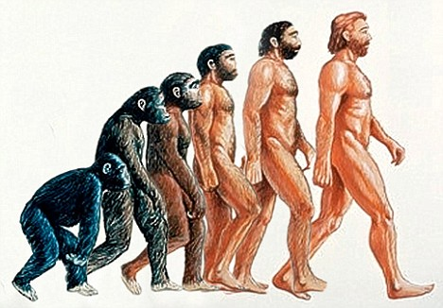
Alleged Scientific Discrepancy
Evolution is often stated but macro-evolution (one species evolving to another species) is theory and not a fact. It has never been observed and not subject to the scientific method.

Slide 54
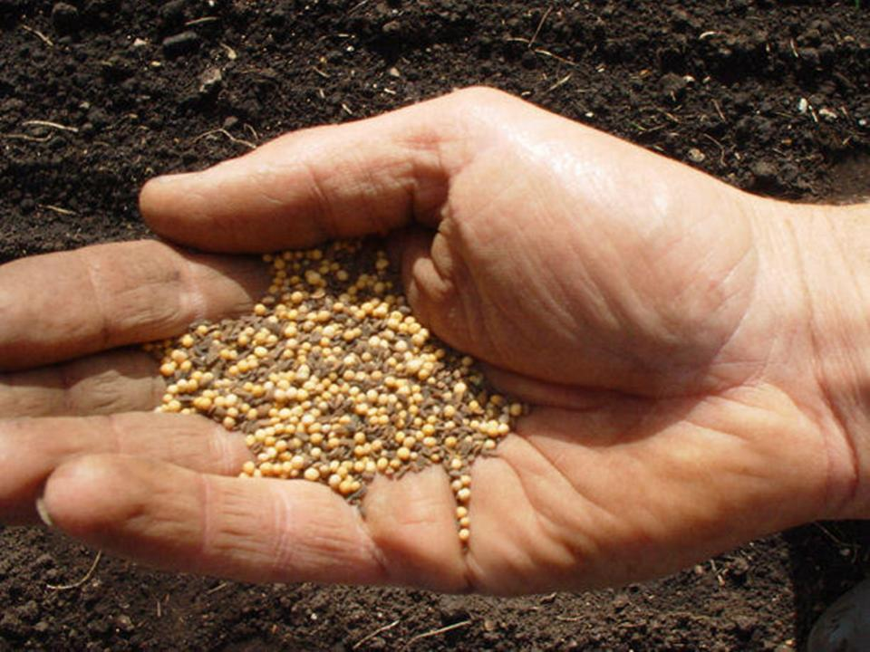
Alleged Scientific Discrepancy
Matthew 13:31 He gave them another parable: “The kingdom of heaven is like a mustard seed that a man took and sowed in his field. 13:32 It is the smallest of all the seeds, but when it has grown it is the greatest garden plant and becomes a tree, so that the wild birds come and nest in its branches.”

Slide 55
Alleged Scientific Discrepancy
Veracity of inerrancy problem for some: The wild orchid seed is smaller.
The statement is proverbial
Jesus is referring only to sown seeds; The wild orchid is not a sown agricultural seed.
Within the Judean world view in their context it was the smallest seed

Slide 56
Once Alleged Historical Discrepancies
Prior to the advent of the archeological era of the 19 and 20th centuries critics often called into question the historicity of the Bible especially the OT in terms of places, peoples and events.
However, over time archeological discoveries have often silenced specific historical criticism.

Slide 57
Three Examples of (Once) Alleged Historical Discrepancies (validated by archeological finds)
The Hittite Empire
In 1876 and later in 1906 evidence of the Hittite capital and language was discovered at Boghaz-koy in modern Turkey.
The Cities of Sodom and Gomorrah
Starting in 1924 excavations were done in the area of the Dead Sea and evidence of cities which had been burned is present during the time of the biblical account.
King David
In 1993 at Tel Dan in Northern Israel a 9th century BC inscription was discovered referring to the “King of Israel” and the “House of David.”
See Patrick Zukeran, http://bible.org/article/archaeology-and-old-testament

Slide 58
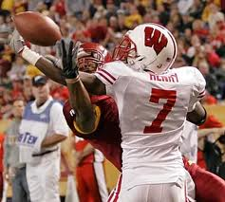
Alleged Bible Contradictions
Differences in parallel passages do not require actual contradictions
Harmonization and understanding that nature of historical reporting most often provides good solutions to differences.
For example in a football game on a pass interference play one reporter states the cornerback bumped the receiver while another states the receiver bumped into the cornerback. Both statements while different may be true but they are being reported from a little different perspective.

Slide 59
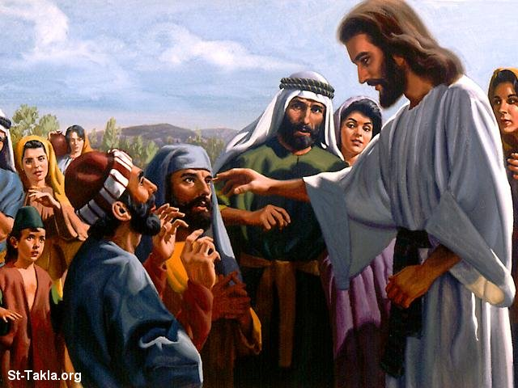
Alleged Bible Contradictions
Two Blind Men or One?
As they were leaving Jericho, a large crowd followed them. Two blind men were sitting by the road. When they heard that Jesus was passing by, they shouted, “Have mercy on us, Lord, Son of David!” (Matt 10:29-30)
They came to Jericho. As Jesus and his disciples and a large crowd were leaving Jericho, Bartimaeus the son of Timaeus, a blind beggar, was sitting by the road. When he heard that it was Jesus the Nazarene, he began to shout, “Jesus, Son of David, have mercy on me! (Mark 10:46-47)””

Slide 60
Alleged Bible Contradictions
Harmonization?
Mark chooses to focus on one of the blind men naming him.
Matthew writing to a Jewish audience may wish to confirm the testimony of the blind men (Jesus = the son of David = a Messianic title) by the Jewish required number of at least two (Deut 17:6).
Because Mark reports that one blind man was healed it does not preclude that another blind man was healed on the same occasion.

Slide 61
Alleged Bible Contradictions
How does one explain the following differences in Peter’s confession at Caesera Phillipi?
Question
Mt 16:13: Who do people say the Son of Man is?”
Mk 8:27 “Who do people say I am?
Lk 9:18 “Who do the crowds say I am?”
Answer
Mt 16:16 “You are the Christ, the Son of the living God
Mk 8:29 “You are the Christ”
Lk 9:20 “The Christ of God”
Sometimes the Bible authors condense speeches and events. This is the nature of historical reporting.

Slide 62
A. INTERPRETATION
Misunderstanding Interpretation
There is but one correct interpretation of Scripture, but many applications.
Correct interpretation of Scripture requires understanding of Context
Who it was written to
When it was written
Why it was written
Who wrote it
What the original hearers would have understood
Then we can apply it to our life as the Holy Spirit inspires us

Slide 63
A. SOLA SCRIPTURA
We affirm BOTH that Scriptures must be interpreted correctly and also that the Holy Spirit helps us understand and apply it personally.
Many Christians today don’t make use of the 2000 years of amazing church writers and theologians who have gained many insights into scripture.
There are Study Bibles, Commentaries, Hebrew and Greek Lexicons and Dictionaries, and many different kinds of TRANSLATIONS
Study to show yourself approved, a workman able to accurately interpret the Word of God

Slide 64
The Power of God unto Salvation The Evidence of Changed Lives
“God’s words will give men new life more than other words that are for pleasure. O marvelous power of the Divine Seed which overpowers strong men in arms, softens hard hearts, and renews and changes into godly men, those men who had been brutalized by sins and departed infinitely far from God.” --- John Wycliffe

