Slide 1
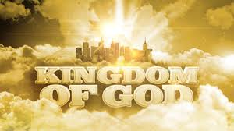
The Power of the Kingdom of God

Slide 2
Questions
If Satan is defeated, then why is his kingdom still obviously present?
Will we ever eradicate evil on the earth?
Will we still make progress against its evil tide?
Where is the kingdom of God?
What difference has the message of the kingdom of God made upon the earth?

Slide 3
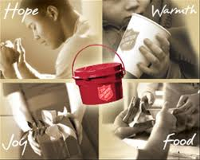

Slide 4
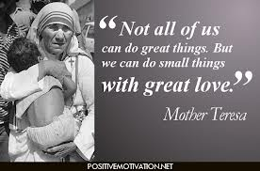

Slide 5
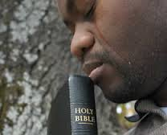

Slide 6
There is much joy that is spread when the kingdom of God is actually manifested.
That’s because there is real power in the kingdom of God, for those who willingly enter it.

Slide 7
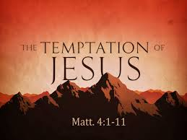

Slide 8
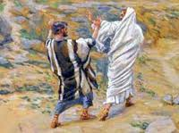
Matthew 16:21-23 (NIV)
Peter took him aside and began to rebuke him. "Never, Lord!" he said. "This shall never happen to you!“
Jesus turned and said to Peter, "Get behind me, Satan! You are a stumbling block to me; you do not have in mind the things of God, but the things of men."

Slide 9
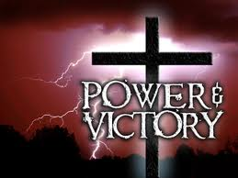
Colossians 2:15 (NIV) ¹⁵ And having disarmed the powers and authorities, he made a public spectacle of them, triumphing over them by the cross.
Hebrews 2:14-15 (NIV) by his death he might destroy him who holds the power of death--that is, the devil-- ¹⁵ and free those who all their lives were held in slavery by their fear of death.
1 John 3:8 (NIV) The reason the Son of God appeared was to destroy the devil's work.

Slide 10
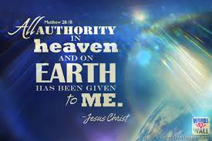

Slide 11
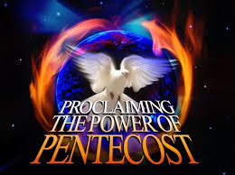

Slide 12
To enter the Kingdom of God
we must be willing to let go of the holdings that Satan offers us in this world system

Slide 13
The Kingdom of God has come
But, not fully – in the sense that everyone on the earth is now in it
It is entered only by choice
And it comes in by the Holy Spirit – entering the choosers (within)

Slide 14
Jesus is Lord
Means that you are totally surrendering to him
Choosing Him and His ways over the ways of the world
Choosing love over selfishness
Choosing delayed gratification over instant
Because you have come to see the better choice
You have come to need and want the power of the kingdom of God in your life

Slide 15
Power for what?
Power to be freed from the slavery of sin
Power to change
Power of a new life
Power of new hope
Power of eternal life
Power to live in love
Power to help others

Slide 16
Acts 2:43-47 (NIV)
⁴³ Everyone was filled with awe, and many wonders and miraculous signs were done by the apostles. ⁴⁴ All the believers were together and had everything in common. ⁴⁵ Selling their possessions and goods, they gave to anyone as he had need. ⁴⁶ Every day they continued to meet together in the temple courts. They broke bread in their homes and ate together with glad and sincere hearts, ⁴⁷ praising God and enjoying the favor of all the people. And the Lord added to their number daily those who were being saved.

Slide 17
Choose
The power to say no – to things that will end up harming you in the end
The power to say yes – to the things of God that will bring you eternal joy
But both choices are still present
The devil’s marketing, at times is much better
But God’s power is much greater

Slide 18
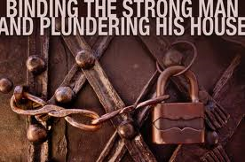

Slide 19
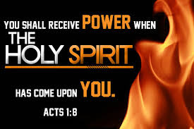

Slide 20
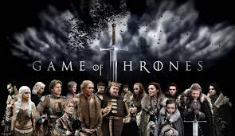

Slide 21
Acts 4:23-35 (NIV)
²³ On their release, Peter and John went back to their own people and reported all that the chief priests and elders had said to them. ²⁴ When they heard this, they raised their voices together in prayer to God. "Sovereign Lord," they said, "you made the heaven and the earth and the sea, and everything in them. ²⁵ You spoke by the Holy Spirit through the mouth of your servant, our father David: "'Why do the nations rage and the peoples plot in vain? ²⁶ The kings of the earth take their stand and the rulers gather together against the Lord and against his Anointed One. ²⁷ Indeed Herod and Pontius Pilate met together with the Gentiles and the people of Israel in this city to conspire against your holy servant Jesus, whom you anointed. ²⁸ They did what your power and will had decided beforehand should happen.

Slide 22
Acts 4:23-35 (NIV)
²⁹ Now, Lord, consider their threats and enable your servants to speak your word with great boldness. ³⁰ Stretch out your hand to heal and perform miraculous signs and wonders through the name of your holy servant Jesus." ³¹ After they prayed, the place where they were meeting was shaken. And they were all filled with the Holy Spirit and spoke the word of God boldly.

Slide 23
Acts 4:23-35 (NIV)
³² All the believers were one in heart and mind. No one claimed that any of his possessions was his own, but they shared everything they had. ³³ With great power the apostles continued to testify to the resurrection of the Lord Jesus, and much grace was upon them all. ³⁴ There were no needy persons among them. For from time to time those who owned lands or houses sold them, brought the money from the sales ³⁵ and put it at the apostles' feet, and it was distributed to anyone as he had need.

Slide 24
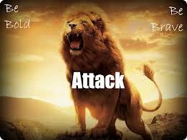
A people to be reckoned with

Slide 25
The Importance and Power of Letting Go to God
Self-will, self-interest, self-centeredness
That is the kingdom of Satan, and God is not going to give you His kingdom on that ground.
That was the ruin and the loss of the kingdom of God for man.

Slide 26
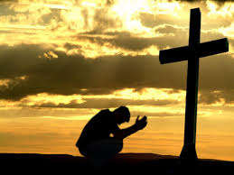
He brings us to the end of ourselves

Slide 27
