Slide 2
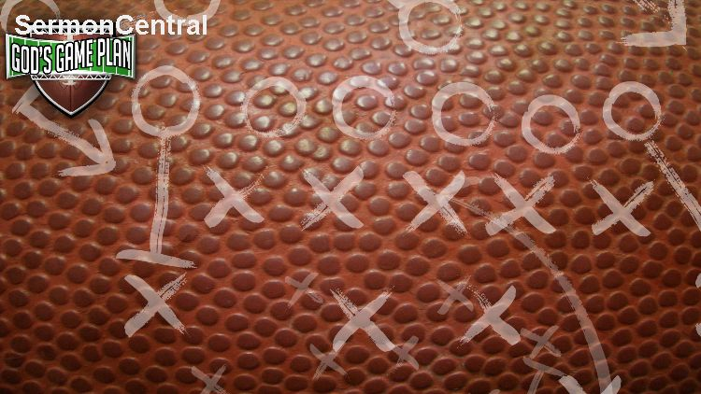
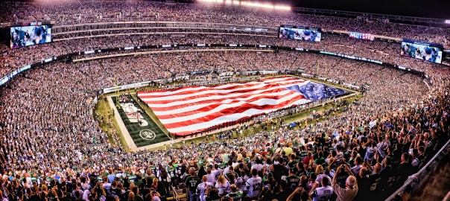

Slide 3
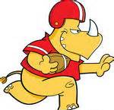

Slide 4
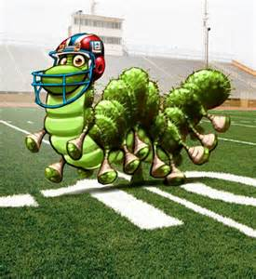

Slide 6
Ransom

Slide 7
Ransom

Slide 8
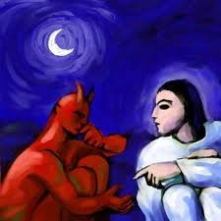
Ransom

Slide 9
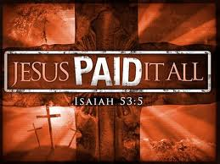
Ransom

Slide 10
Ransom
The devil had dominion over man
God regained the freedom of mankind through the cross of Jesus Christ
Jesus as the precious jewel of heaven was a prize worth more than all of mankind.

Slide 11
Ransom
There is a battle going on in this world
In the cross a great victory was won
The Ransom was paid.
"For the Son of man also came not to be served but to serve, and to give his life as a ransom for many" (Mk. 10:45).
"You are not your own; you were bought with a price" (1 Cor. 6:19-20).

Slide 12
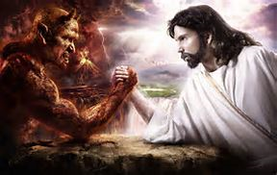
Ransom
While there is a struggle going on in this world, we must not imagine that the devil is an equal to God in the warfare.

Slide 13
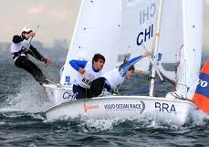
MORAL INFLUENCE

Slide 14
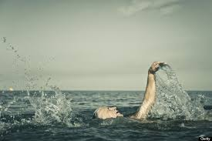
MORAL INFLUENCE

Slide 15
MORAL INFLUENCE

Slide 16
MORAL INFLUENCE
Jesus death was a powerful example of how much God loves us and how much he hates sin.
This death was the best way that God could make an impression upon sinful mankind.
Some are changed by that impression, and due to his example they become the kind of persons God would have them to be.

Slide 17
MORAL INFLUENCE
"Christ also suffered for you, leaving you an example, that you should follow in his steps" (1 Pet. 2:21).
The cross shows us the amazing love of God and has a powerful influence upon people for good.
Jesus said, "I, when I am lifted up from the earth, will draw all men to myself" (Jn. 12:32).
The cross is able to soften the hearts of some sinners and bring them to their knees in repentance.

Slide 18
MORAL INFLUENCE
The cross of Jesus was more than just an example.
The death of Jesus was more than a martyr's death.
Many other good men have died for good causes in history.
Throughout the centuries the death of other human beings has inspired and motivated others.
So the question of the distinctiveness of Christ's death is at stake.
In what way does his death atone?
How is his death different?

Slide 19
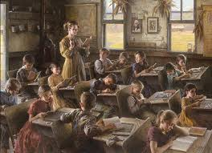
GOVERNMENTAL

Slide 20
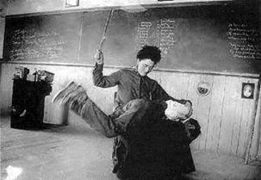
GOVERNMENTAL

Slide 21
GOVERNMENTAL
If God merely forgave us with no punishment man would not take sin very seriously and continue in sin saying, "God will forgive me anyway."
In order to preserve a respect for law and order, God needed to punish sin before he could forgive mankind.
The cross, then, was a warning to man that God takes sin seriously.
Now that real punishment has been suffered by Jesus for our sin God is free to forgive us.

Slide 22
GOVERNMENTAL
The cross does show us that sin is serious.
Sin is serious enough that God allowed his only Son to die on the cross.
The wages of sin is death (Rom. 6:23).
Keeping God's laws and living righteously is important.
If we take sin lightly in our dealing with our fellow man, we may see the unfortunate result of people taking the grace of God for granted (Rom. 6:1-2).

Slide 23
GOVERNMENTAL
We should not imply that God could have forgiven all mankind, without judging sin.
No, God does not forgive us automatically, because God is righteous and holy. God cannot bear the presence of sin.
The death of Jesus was not done just for effect.
Like a mother crying and attempt to shame her child into a right course of action.

Slide 24
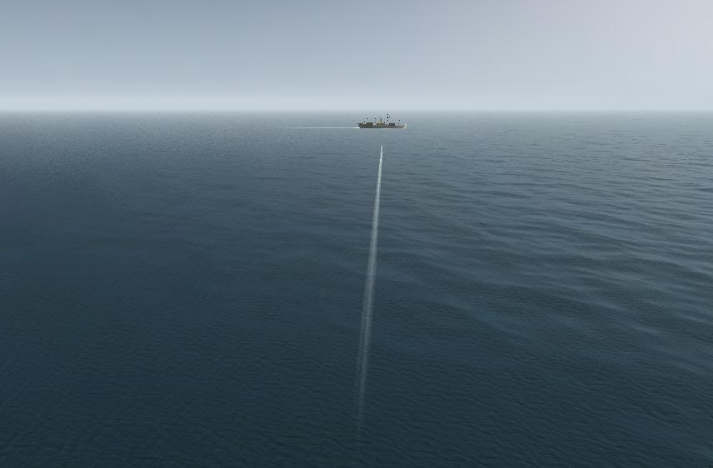
Substitution

Slide 25
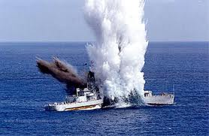
Substitution

Slide 26
Substitution
"Greater love hath no man than this, that a man lay down his life for his friends" (Jn. 15:13).
Man cannot pay for his own sins.
Sin is so serious that it deserves the death penalty.
Jesus came into the world, not just to be an example that would influence us, but to literally take our place and be a substitute for us.
His death was the penalty of death that mankind deserved.
In this manner God can forgive sinful mankind and remain both just and loving.

Slide 27
Substitution
He was wounded for our transgressions, he was bruised for our iniquities" (Isa. 53:5).
"For Christ also died for sins once for all, the righteous for the unrighteous, that he might bring us to God" (1 Pet. 3:18).
"God shows his love for us in that while we were yet sinners Christ died for us" (Rom. 5:8).
"We are convinced that one has died for all" (2 Cor. 5:14).

Slide 28
Substitution
Jesus was not forced to go to the cross. It was a voluntary decision on his part.
He said, "For this reason the Father loves me, because I lay down my life, that I may take it again. No one takes it from me, but I lay it down of my own accord. I have power to lay it down, and I have power to take it again" (Jn. 10:17-18).
We must not think of God as an unjust Father who made his innocent Son suffer for someone else against his will.

Slide 29
Substitution
we are dealing with four parties:
the criminal
the offended party
the judge (law)
a substitute

Slide 30
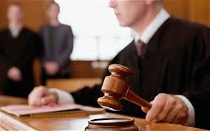
Substitution

Slide 31
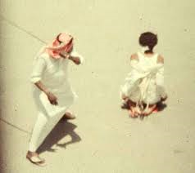
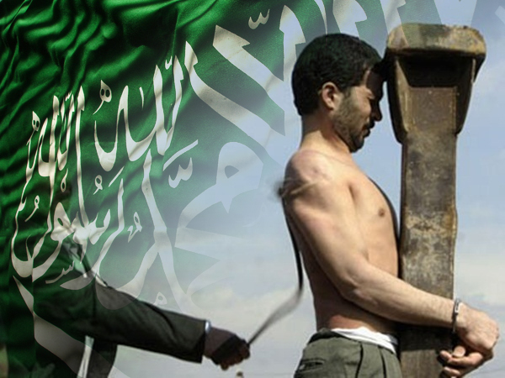
Substitution

Slide 32
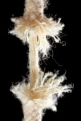
Power in the Blood

Slide 33
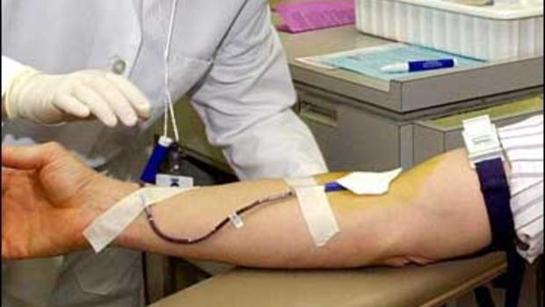
Power in the Blood

Slide 34
Power in the Blood
The blood shall be a sign for you, upon the houses where you are; and when I see the blood, I will pass over you, and no plague shall fall upon you to destroy you (Ex. 12:13).

Slide 35
Power in the Blood
For the life of the flesh is in the blood; and I have given it for you upon the altar to make atonement for your souls; for it is the blood that makes atonement, by reason of the life (Lev. 17:11).

Slide 36
Power in the Blood
"Indeed, under the law almost everything is purified with blood, and without the shedding of blood there is no forgiveness of sins" (Heb. 9:22).
"It is impossible that the blood of bulls and goats should take away sins" (Heb. 10:4).

Slide 37
Power in the Blood
At the institution of the Lord's Supper Jesus said, "This is my blood of the covenant, which is poured out for many for the forgiveness of sins" (Mt. 26:28).

Slide 38
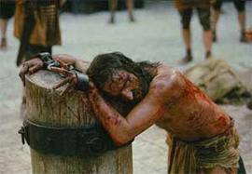
Power in the Blood

Slide 39
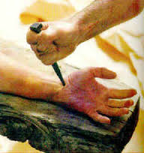
Power in the Blood

Slide 40
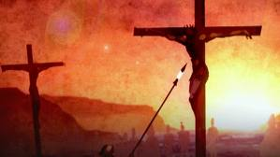
Power in the Blood

Slide 41
Power in the Blood
You know that you were ransomed...with the precious blood of Christ, like that of a lamb without blemish or spot" (1 Pet. 1:18-19)
"his blood did ransom men for God" (Rev. 5:9).

Slide 42
Power in the Blood
Paul says we have redemption in Christ "through his blood" (Eph. 1:7).
The church is purchased or obtained by the blood of Christ (Acts 20:28).
"You are not your own, you were bought with a price" (1 Cor. 6:19-20).

Slide 43
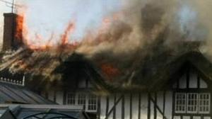
Power in the Blood

Slide 44
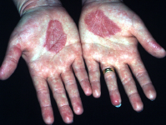
Power in the Blood

Slide 45
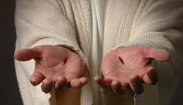
Power in the Blood

Slide 46
THE CROSS AS VICTORY
"In all these things we are more than conquerors through him who loved us" (Rom. 8:37).
"But thanks be to God, who gives us the victory through our Lord Jesus Christ" (1 Cor. 15:57).
"For whatever is born of God overcomes the world; and this is the victory that overcomes the world, our faith" (1 Jn. 5:4).

Slide 47
THE CROSS AS VICTORY
VICTORY OVER SIN
VICTORY FROM THE LAW
VICTORY OVER DEATH
VICTORY OVER THE DEVIL AND EVIL

Slide 48
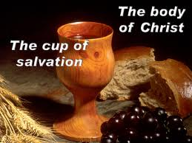
THE LORD’S SUPPER

